Slide 1

DON’T. PANIC.
By Nicholas R. Smith

Slide 2

Who am I?
Notes:
I owe a great deal to GU and it is my privilege to come back and offer something back to this great community

Slide 3
Notes:
Me! At the WSU Hackathon in 2016
Anecdote about learning ActionScript as my first programming language

Slide 4



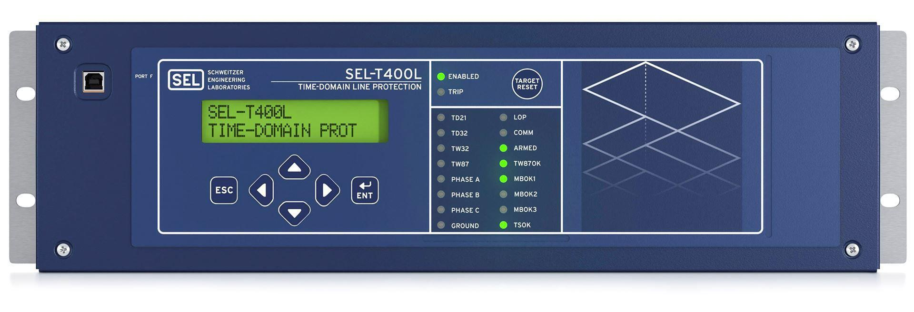
Notes:
Based in Pullman, WA. Go cougars!

Slide 5
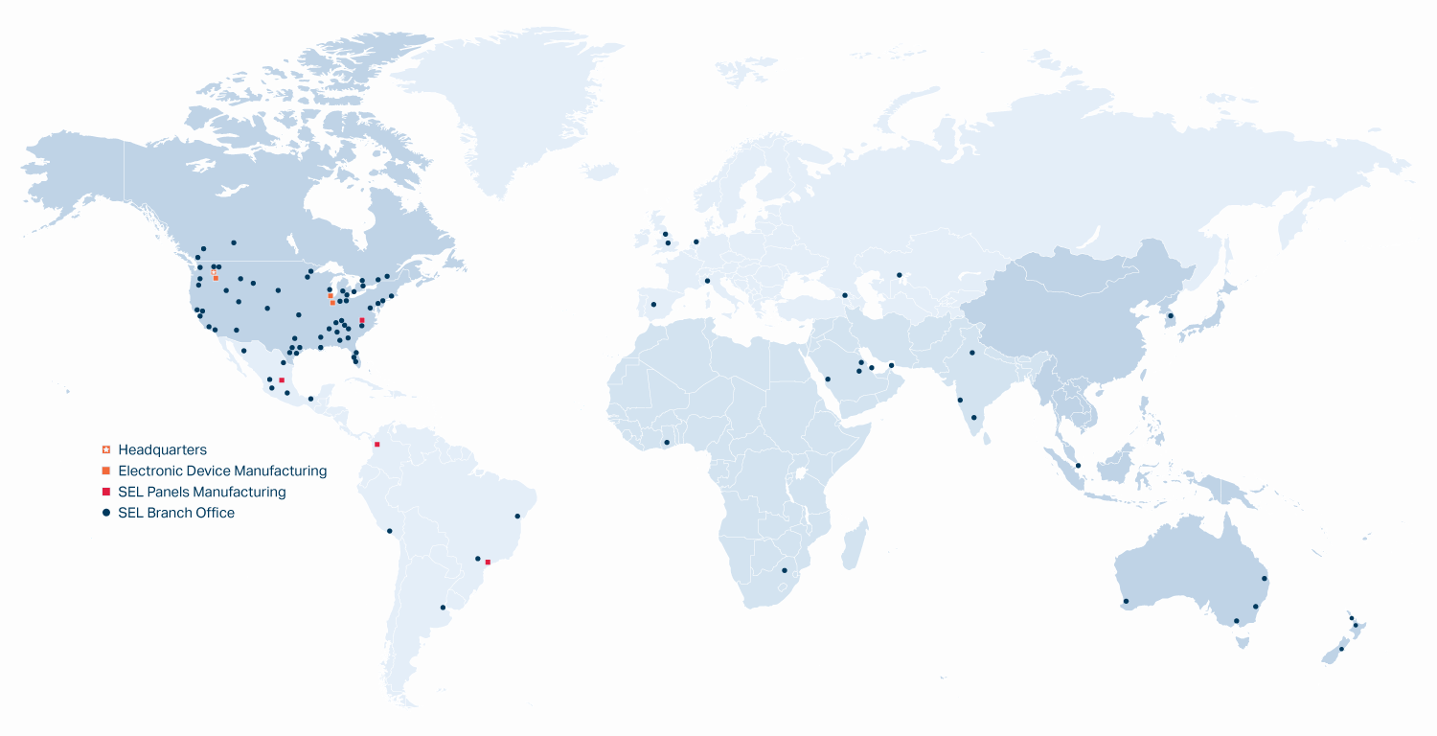
Notes:
International outreach

Slide 6
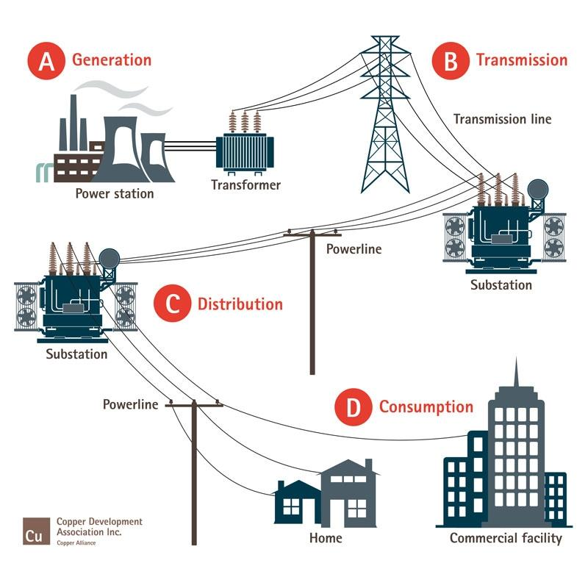
The Power Grid

Slide 7
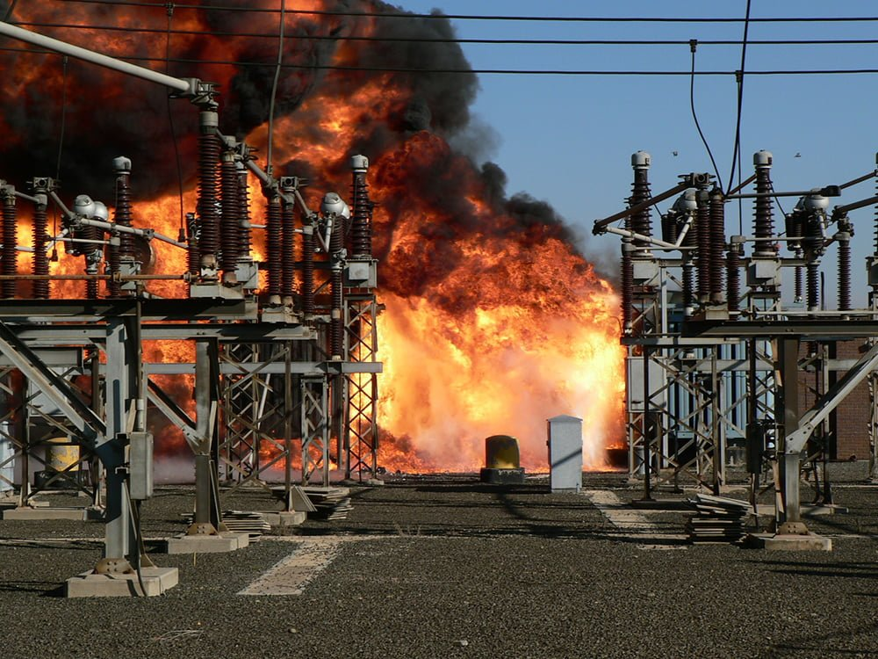

Slide 8

Notes:
Williamsburg Waterfront in Brooklyn
9PM during hurricane Sandy in the fall of 2012
Watch the lights on the power plant go out after the explosion

Slide 9
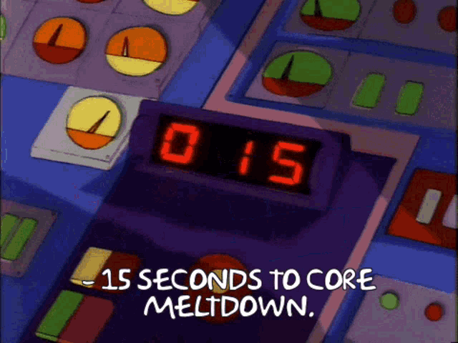

Slide 10

California Wildfires
Pacific Gas & Electric (PG&E) responsible for sparking “at least 1,500 California fires”¹
PG&E equipment “started more than one fire a day in California on average in recent years”¹
Responsible for the Dixie Fire, the “second largest fire in California’s history”²
1. Gold, R., Blunt, K., & Smith, R. (2019, February 28). PG&E sparked at least 1,500 California fires. now the utility faces collapse. The Wall Street Journal. Retrieved April 29, 2023, from https://www.wsj.com/articles/pg-e-sparked-at-least-1-500-california-fires-now-the-utility-faces-collapse-11547410768
2. Newburger, E. (2022, January 5). California finds PG&E equipment responsible for massive Dixie Fire. CNBC. Retrieved April 29, 2023, from https://www.cnbc.com/2022/01/05/california-finds-pge-equipment-responsible-for-massive-dixie-fire-.html
Notes:
Sources:
Gold, R., Blunt, K., & Smith, R. (2019, February 28). PG&E sparked at least 1,500 California fires. now the utility faces collapse. The Wall Street Journal. Retrieved April 29, 2023, from https://www.wsj.com/articles/pg-e-sparked-at-least-1-500-california-fires-now-the-utility-faces-collapse-11547410768
Newburger, E. (2022, January 5). California finds PG&E equipment responsible for massive Dixie Fire. CNBC. Retrieved April 29, 2023, from https://www.cnbc.com/2022/01/05/california-finds-pge-equipment-responsible-for-massive-dixie-fire-.html
Wall Street Journal: https://www.wsj.com/articles/pg-e-sparked-at-least-1-500-california-fires-now-the-utility-faces-collapse-11547410768
CNBC: https://www.cnbc.com/2022/01/05/california-finds-pge-equipment-responsible-for-massive-dixie-fire-.html

Slide 11
https://video.selinc.com/detail/videos/solutions/video/1760467218219293040/falling-conductor-mitigation-demonstration?autoStart=true
Notes:
PMU = Phasor Measurement Unit, measures voltage and current amplitude and phases
I had the privilege and responsibility of writing new firmware for the RTAC, this device that takes in data from the PMUs and make the decision to trip the breaker

Slide 12
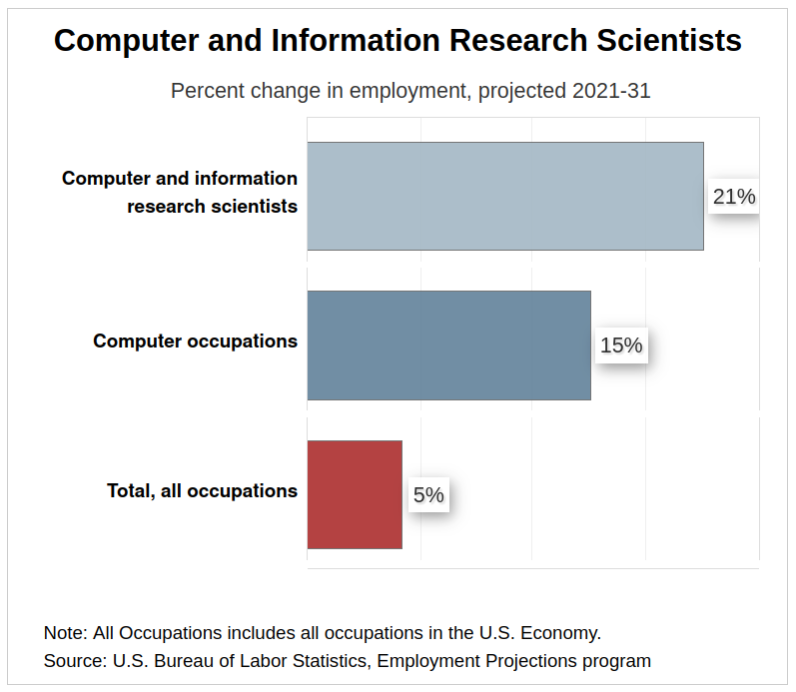
21% increase
Bureau of Labor Statistics, U.S. Department of Labor, Occupational Outlook Handbook, Computer and Information Research Scientists, visited (March 20, 2023) at https://www.bls.gov/ooh/computer-and-information-technology/computer-and-information-research-scientists.htm
Notes:
So that’s SEL, and that’s a bit about what we do and what I’m apart of. Now, I’d like to shift the focus to you all and where you’re at

Slide 13
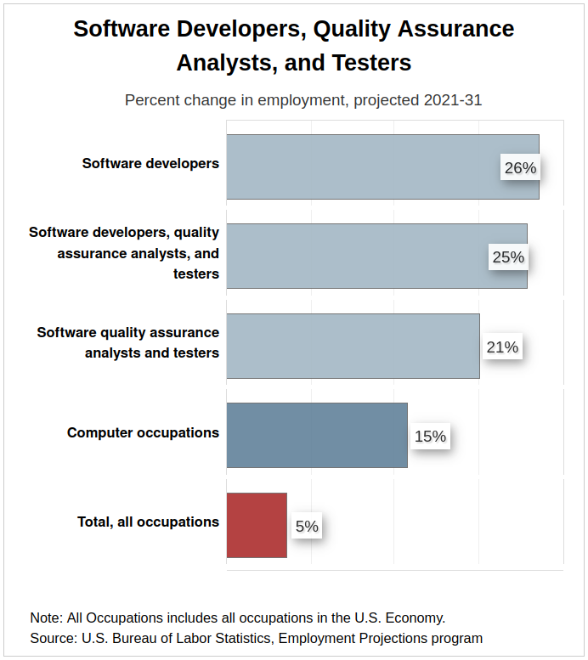
26% increase
Bureau of Labor Statistics, U.S. Department of Labor, Occupational Outlook Handbook, Software Developers, Quality Assurance Analysts, and Testers, visited (April 22, 2023) at https://www.bls.gov/ooh/computer-and-information-technology/software-developers.htm

Slide 14
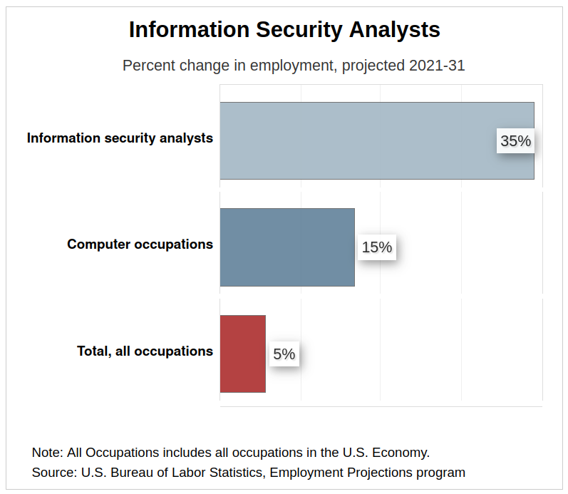
35% increase
Bureau of Labor Statistics, U.S. Department of Labor, Occupational Outlook Handbook, Information Security Analysts, visite ((visited April 12, 2023) at https://www.bls.gov/ooh/computer-and-information-technology/information-security-analysts.htm
Notes:
A software engineer to a information security analyst is like a writer to an editor. Both are necessary to produce something high quality, but their roles are different

Slide 15
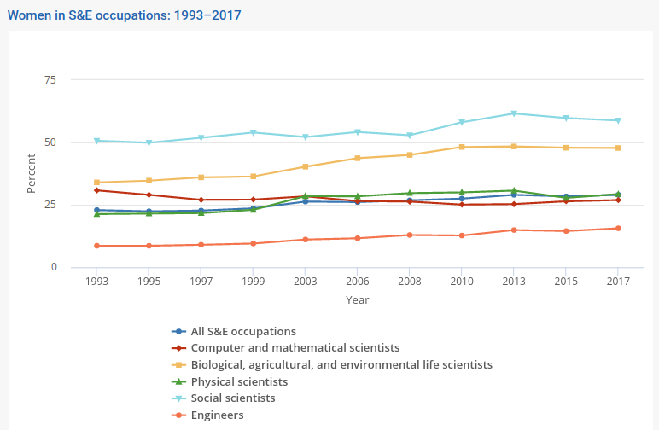
National Science Board, National Science Foundation. 2019. Science and Engineering Indicators 2020: Science and Engineering Labor Force. Science and Engineering Indicators 2020. NSB-2019-8. Alexandria, VA. Available at https://ncses.nsf.gov/pubs/nsb20198/.
Notes:
According to Department of Labor Bureau of Labor Statistics, approximately 26% of all computing workforce jobs were occupied by women in 2021

Slide 16

331% increase in girls taking CS AP exams in 2016
College Board AP Program Summary Report, 2016, 2021

Slide 17
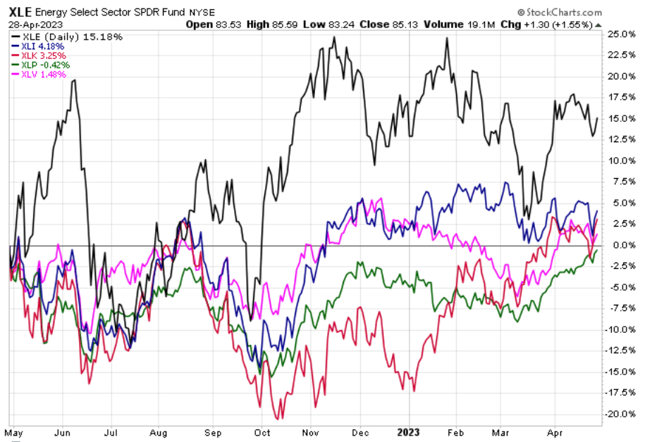
Energy Sector
Industrial Sector
Health Care Sector
Consumer Staples
Technology Sector
Notes:
XLE = Energy Sector Fund
XLI = Industrial Sector Fund
XLK = Technology Sector Fund
XLP = Consumer Staples Sector Fund
XLV = Health Care Sector Fund

Slide 18
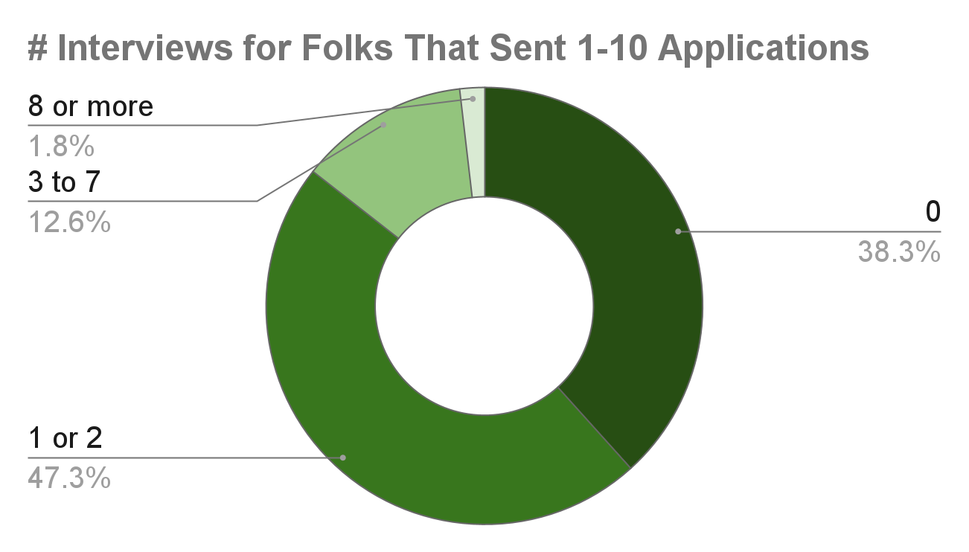
Michael R. Dalton and Jeffrey A. Groen, “How do jobseekers search for jobs? New data on applications, interviews, and job offers,” Beyond the Numbers: Employment & Unemployment, vol. 9, no. 14 (U.S. Bureau of Labor Statistics, November 2020), https://www.bls.gov/opub/btn/volume-9/how-do-jobseekers-search-for-jobs.htm

Slide 19
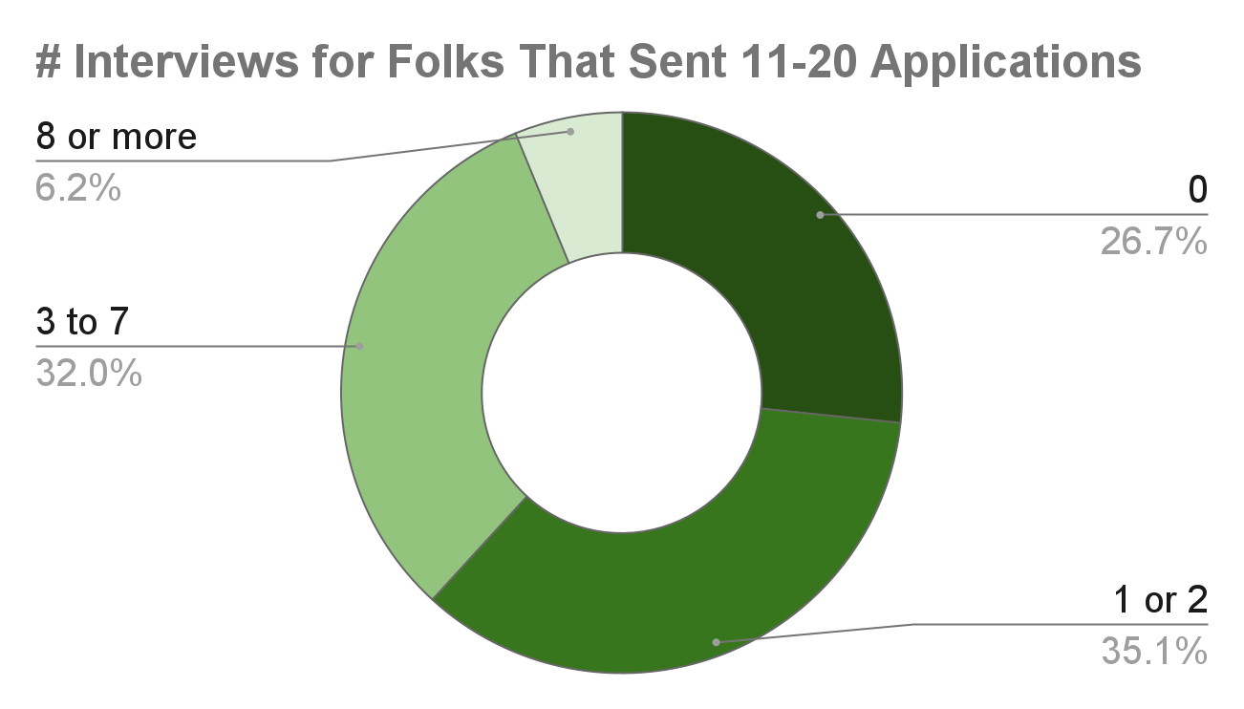
Michael R. Dalton and Jeffrey A. Groen, “How do jobseekers search for jobs? New data on applications, interviews, and job offers,” Beyond the Numbers: Employment & Unemployment, vol. 9, no. 14 (U.S. Bureau of Labor Statistics, November 2020), https://www.bls.gov/opub/btn/volume-9/how-do-jobseekers-search-for-jobs.htm

Slide 20
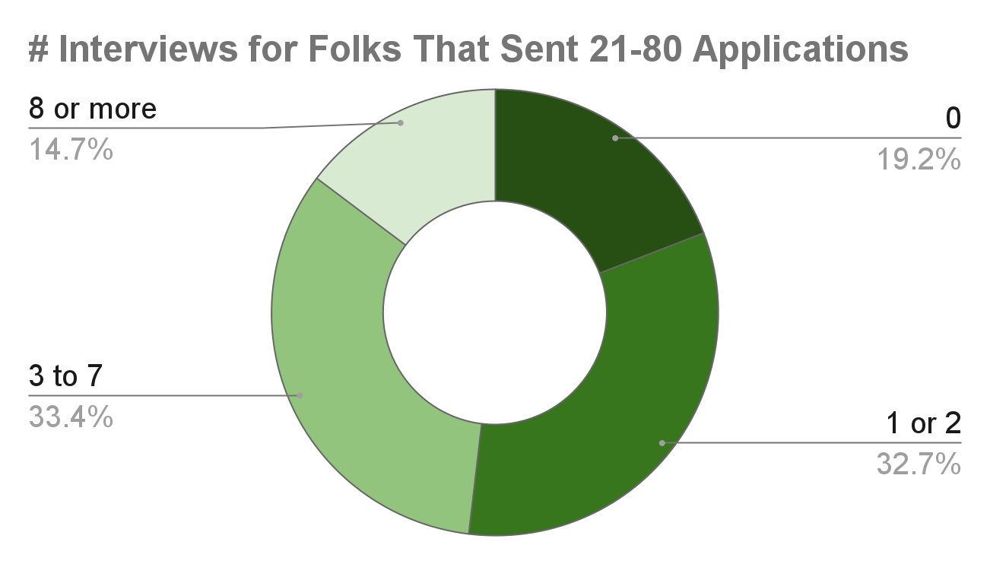
Michael R. Dalton and Jeffrey A. Groen, “How do jobseekers search for jobs? New data on applications, interviews, and job offers,” Beyond the Numbers: Employment & Unemployment, vol. 9, no. 14 (U.S. Bureau of Labor Statistics, November 2020), https://www.bls.gov/opub/btn/volume-9/how-do-jobseekers-search-for-jobs.htm

Slide 21
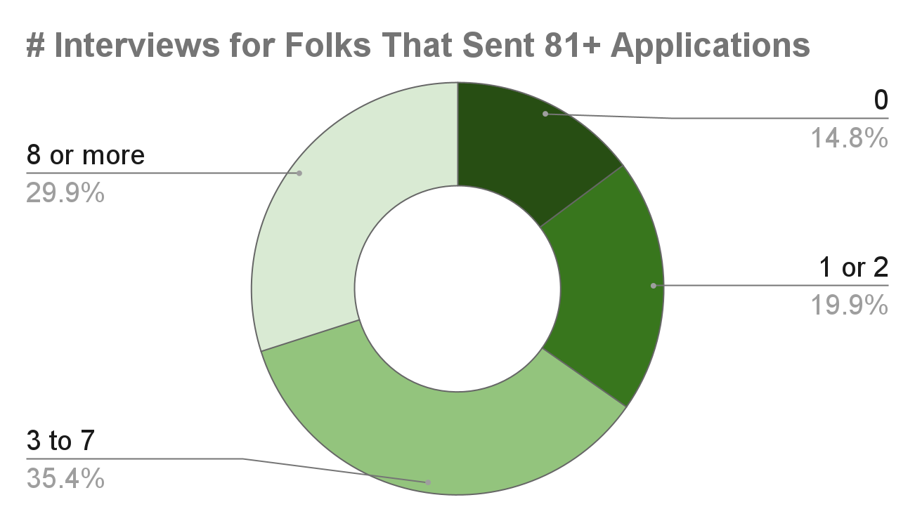
Michael R. Dalton and Jeffrey A. Groen, “How do jobseekers search for jobs? New data on applications, interviews, and job offers,” Beyond the Numbers: Employment & Unemployment, vol. 9, no. 14 (U.S. Bureau of Labor Statistics, November 2020), https://www.bls.gov/opub/btn/volume-9/how-do-jobseekers-search-for-jobs.htm

Slide 22
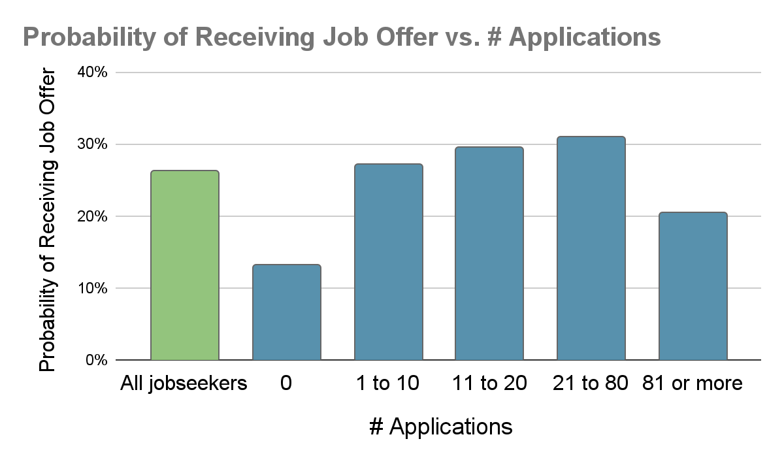
Michael R. Dalton and Jeffrey A. Groen, “How do jobseekers search for jobs? New data on applications, interviews, and job offers,” Beyond the Numbers: Employment & Unemployment, vol. 9, no. 14 (U.S. Bureau of Labor Statistics, November 2020), https://www.bls.gov/opub/btn/volume-9/how-do-jobseekers-search-for-jobs.htm
Notes:
The lesson here is that, well before you find yourself sending out 81 applications, schedule a meeting with career and professional development. They are literally paid to help you find a job

Slide 23
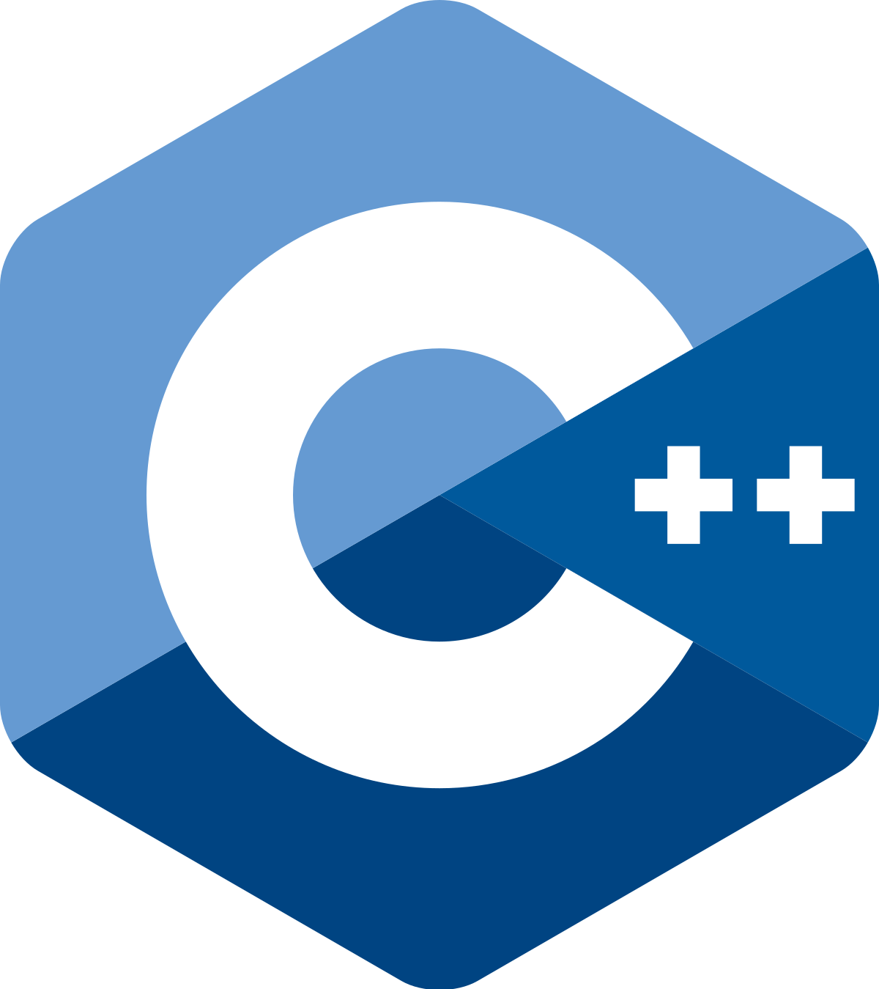


(Paid) Work I’ve Done So Far
5 months embedded C++
5 months Golang
GTK 3.0 for GUI design
kubernetes
Bash scripting CI/CD tools
Jenkins
(Learning) Rust

Slide 24
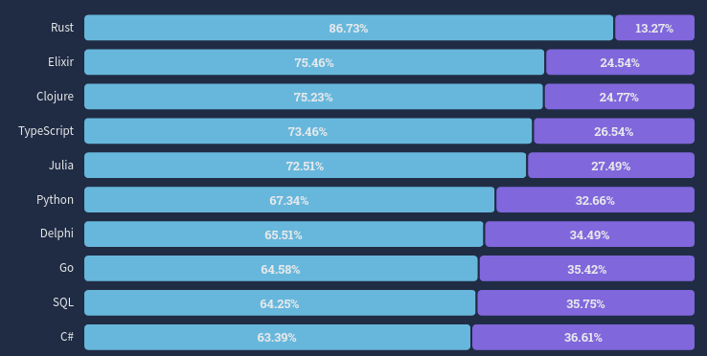
Stackoverflow 2022 Survey: https://survey.stackoverflow.co/2022/?utm_source=thenewstack&utm_medium=website&utm_content=inline-mention&utm_campaign=platform#section-most-loved-dreaded-and-wanted-programming-scripting-and-markup-languages
Notes:
Loved in blue, dreaded in purple
Note that C++ was ranked 25. Note that there is generally a correlation between how new a language is and how well liked that language is, so take these results with a grain of salt

Slide 25
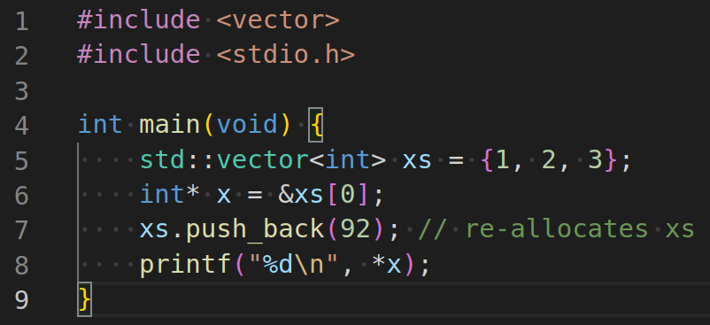
Notes:
And I didn’t want to end today without showing you a little code, so here is a very simple program pushing a new integer to a standard vector.
Can anyone spot the bug?

Slide 26
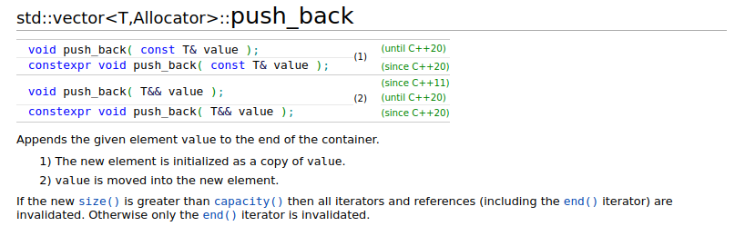
Source: C++ Reference, “std::vector<T,Allocator>::push_back”. Accessed May 1, 2023. Retrieved from https://en.cppreference.com/w/cpp/container/vector/push_back

Slide 27
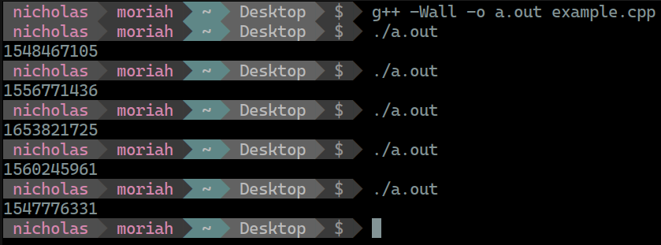

Slide 28
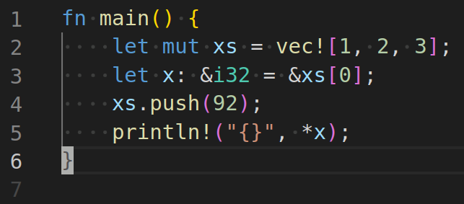

Slide 29
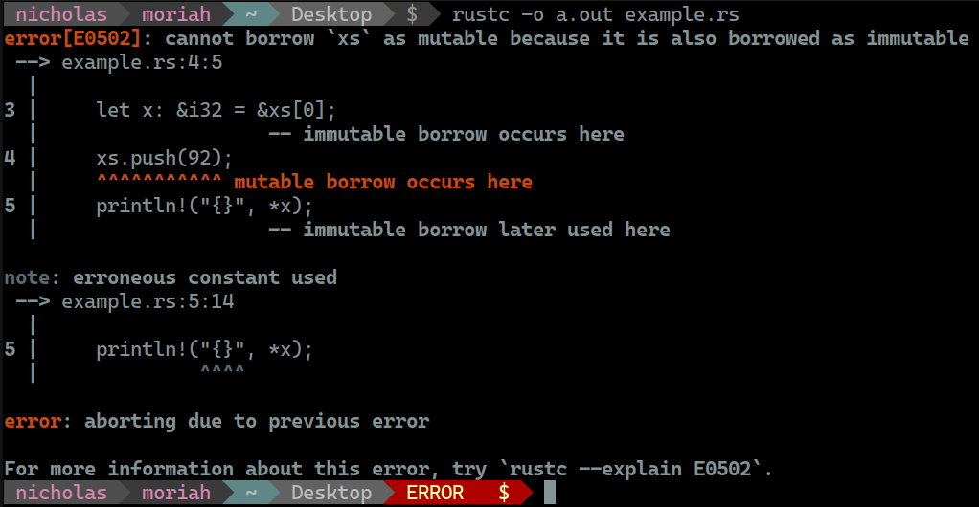

Slide 30



How To Get Good.
git
personal projects
passion
Version control system used by almost every company doing software development
GitHub is your friend
New ideas or building off the ideas of others
Don’t just do something because it’s a resume builder, do it because you love it!
Notes:
Learn about interfaces
Learn about mocking and code coverage tools for unit testing
Documentation is so important. Mermaid diagrams and draw.io are an amazing way to create communicate higher level design concepts quickly

Slide 31


Thank you!!!
SEL Careers Website:
QR Code for Slides:
Notes:
Thank you all for your time. I hope this presentation has given a number of reasons not to panic as the summer approaches. I’d be happy to take take any remaining questions

